Slide 1
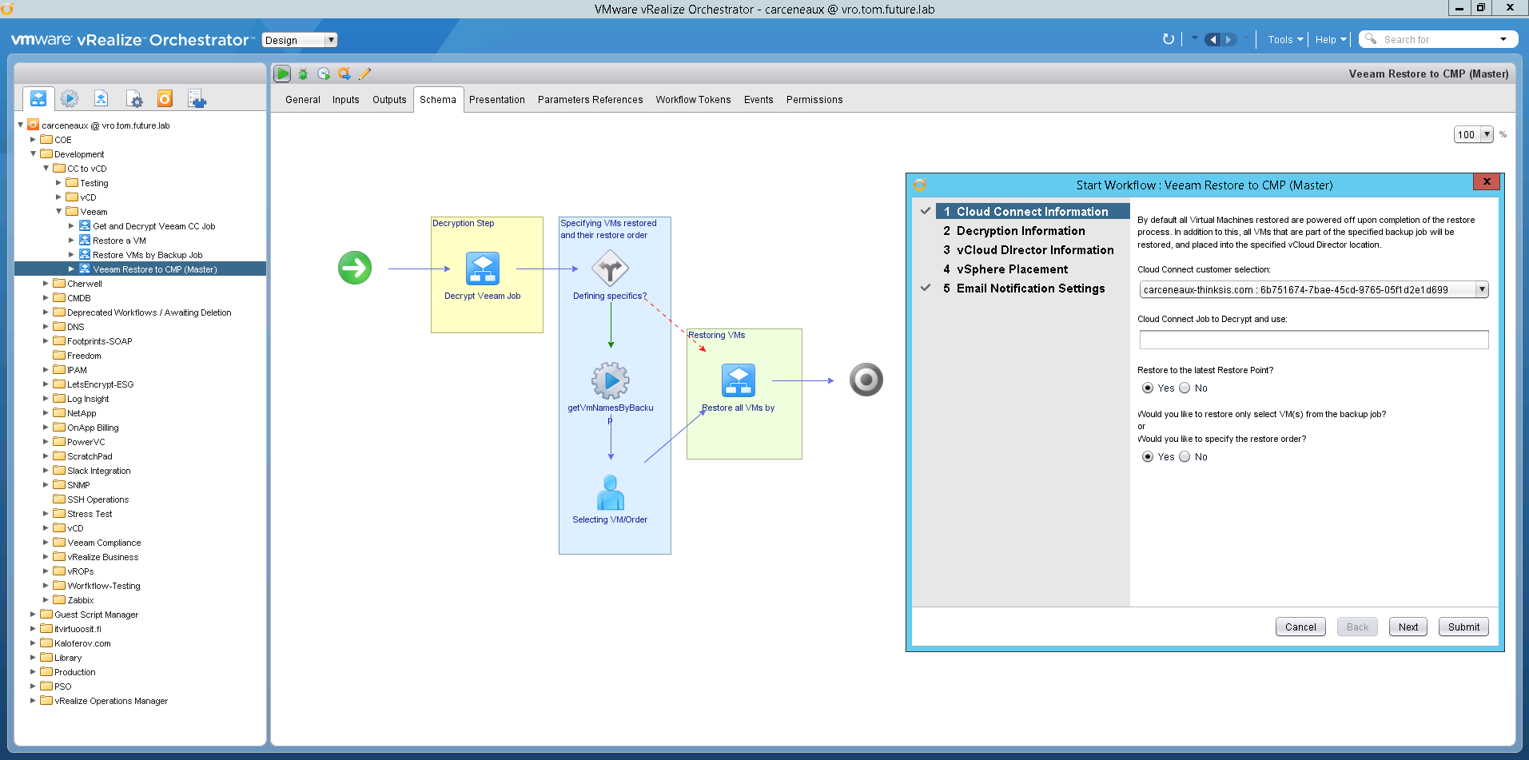
Simplifying vSphere Automation with vRealize Orchestrator

Slide 2
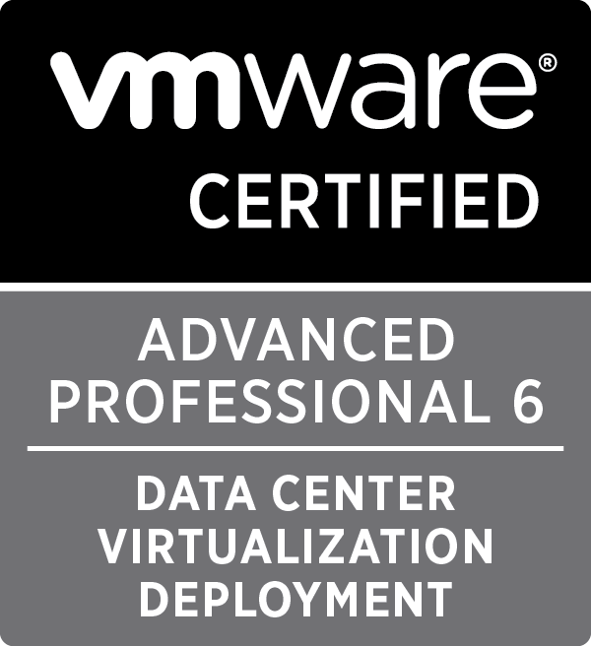
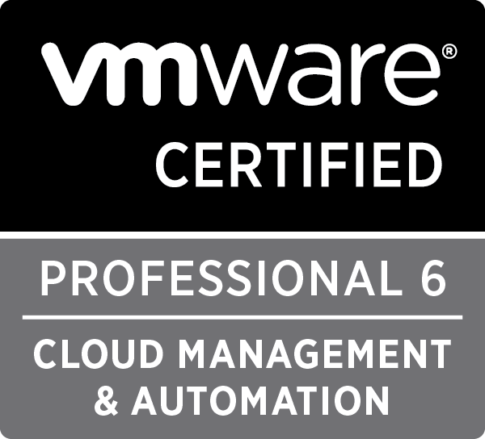
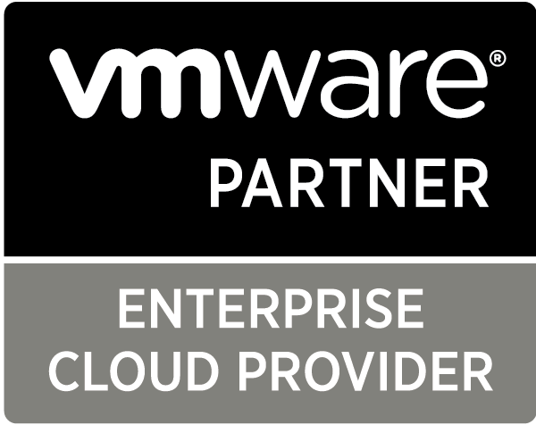
Chris Arceneaux
Automation Engineer at SIS
carceneaux@thinksis.com
@chris_arceneaux
Blog: arsano.ninja

Slide 3
What is vRealize Orchestrator (vRO)?
VMware’s Orchestration and Extensibility Engine
Quickly and easily design and deploy scalable workflows to automate complex IT processes.
Create your own workflows, or leverage generic plug-ins based on SOAP, REST operations and PowerShell scripts.

Slide 4
vRO Licensing
It’s “FREE”!!!
Full vRO
vCenter Standard and above
vRO Player (Read-Only)
vCenter Foundation
vCenter Essentials

Slide 5
Highlights of vRO
GUI Workflows
Automated Generation of Documentation
Built-In Plugins
vCenter
NSX
SQL
Puppet
PowerShell Host Support (winrm)
Linux Host Support (ssh)
Much more
REST API Support
HA Support (Clustering)

Slide 7
Cons of vRO
No git support
Limited Jenkins support
Limited CI/CD pipeline support
Integration with vSphere Web Client (depends)

Slide 8
Is vRO right for you?

Slide 9
Questions?

Slide 10
Useful Links
Developing with VMware vRealize Orchestrator
vRO Coding Design Guide
vRO Community Plug-Ins
https://www.vcoteam.info
VMware Solution Exchange for vRO
VMware Code for vRO
VMware Code Sample Exchange - https://code.vmware.com/samples
VMware Community Forums for vRO
Slides available at: http://arsano.ninja

